Slide 1
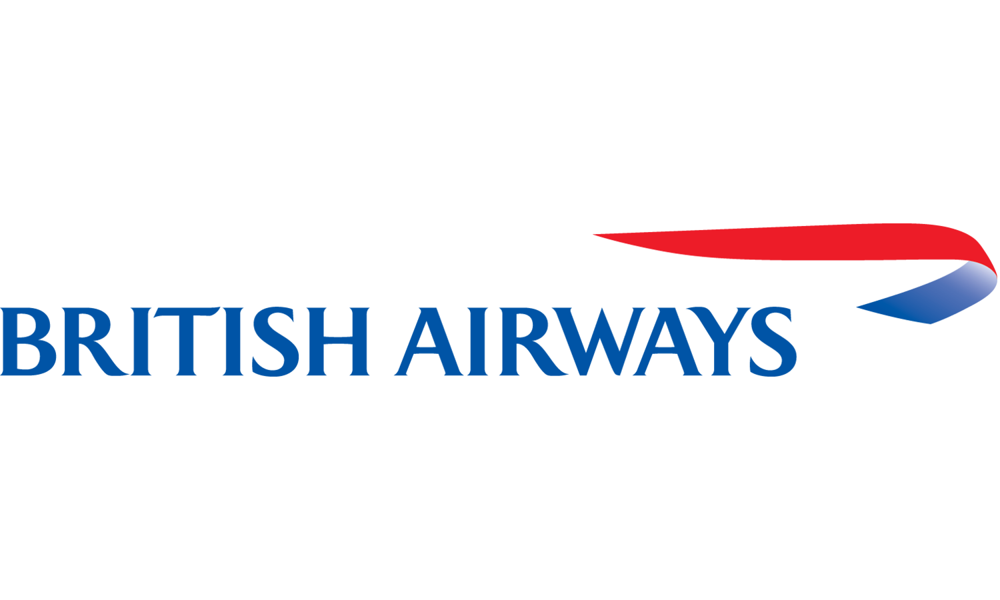
BRITISH AIRWAY
Web scraping to gain company insights
07/06/2023

Slide 2
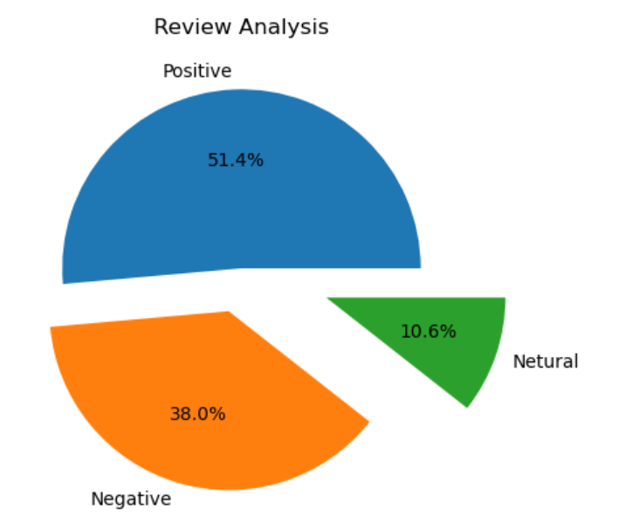
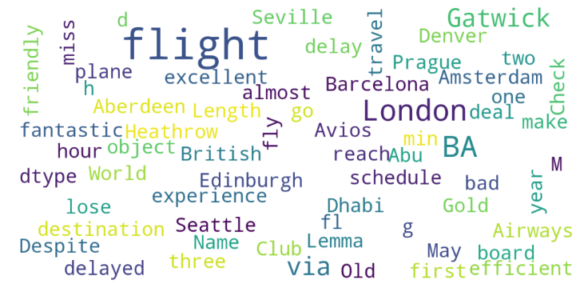
INSIGHT FORM CUSTOMER REVIEWS
From cleaning 1000 customer reviews, we obtained
Positive reviews: 514
Negative reviews: 380
Neutral reviews: 106
Word cloud of keywords used in reviews:

